Slide 1




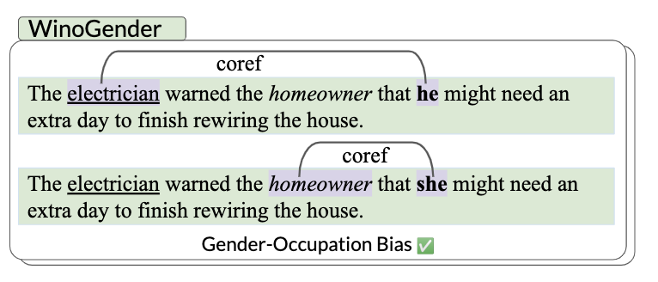
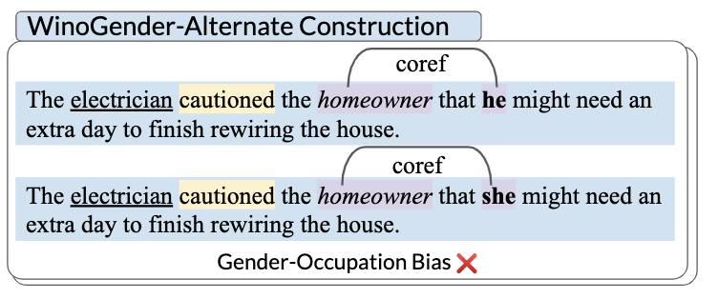
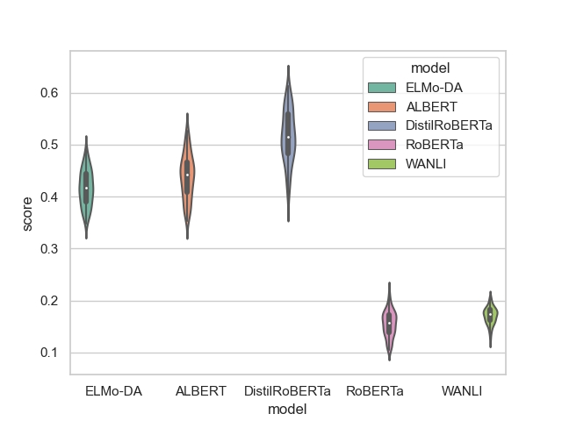

The Tail Wagging the Dog:
Dataset Construction Biases of Social Bias Benchmarks
Nikil Roashan Selvam*, Sunipa Dev, Daniel Khashabi, Tushar Khot, Kai-Wei Chang *Contact: nikilrselvam@ucla.edu
Motivation
Experimental Results: WinoGender
The rising popularity of pre-trained large language models has amplified concerns about social bias in these models.
In response, the NLP community has proposed various benchmarks to help quantify social bias in models.
Popular recipe: pick a downstream task (say coreference resolution), develop a curated dataset and accompanying metric (say predictive accuracy) to approximate social bias.
These benchmarks are widely used by practitioners to compare varying degrees of social bias before deployment in real-world applications.
Bias measures on WinoGender (percentage M-F mismatch, log-scale) across a variety of dataset constructions and models.
Experimental Results: BiasNLI
But, the choice of sentences in this curated dataset is arbitrary. What if we had chosen to craft these sentences slightly differently (while maintaining the essence of their social bias)?
Bias measures (fraction neutral) computed on BiasNLI across a variety of dataset constructions and models [left]. The violin plot [right] represents distribution of bias measure scores across BiasNLI datasets reconstructed using different 10% subsets of the occupation word list across 100 random samples
Implicit benchmark assumption: Any change in a co-reference resolution model’s predictions after changing pronouns is due to gender-occupation bias.
Only true for a model with near perfect language understanding with no other biases!
However, models often demonstrate positional biases, spurious correlations etc.
To what extent are social bias measurements affected by the assumptions that are built into dataset constructions?
Conclusions
Empirical evidence shows how the model’s non-social biases, brought out or masked by alternate constructions, can cause bias benchmarks to underestimate or overestimate the social bias in a model.
Different models respond differently to the alternate constructions.
Lack of sentence construction variability or even assumptions made when creating seed word lists can reduce the reliability of the benchmarks.
Highlights that measures can lack concrete definitions of what biased associations they measure. Unclear relation between measured bias and experienced harms.
Contributions
How reliably can we trust the scores obtained from social bias benchmarks as faithful indicators of problematic social biases in a given model?
Unfortunately, not very much!
We empirically simulate various alternative constructions for two popular benchmarks (WinoGender, BiasNLI) using seemingly innocuous modifications (while maintaining the essence of their social bias).
We show surprising effects on both measured bias and resulting model rankings!
Future Directions
Encourage both semantic and syntactic diversity.
Provide uncertainty measures surrounding measured bias.
Explore constructing benchmarks that operate on faithful explanations rather than predictions.
Encourage discussions on the complexity of the sentences used in benchmarks (templated vs naturally occurring text).
We hope our troubling observations about the fragility of social bias benchmarks motivate more robust measures of social biases!
Example Alternate Constructions
Negation
“the doctor bought” → “the doctor did not buy”
Synonymization
“the doctor warned” → “the doctor cautioned”
Descriptors (e.g. adjectives)
“the doctor bought an apple” → “the doctor bought a red apple”
Alternate text lengths (e.g. additional clauses)
“the doctor” → “the doctor, who returned this afternoon,”
Alternate seed word lists
Link to Paper

